Slide 1
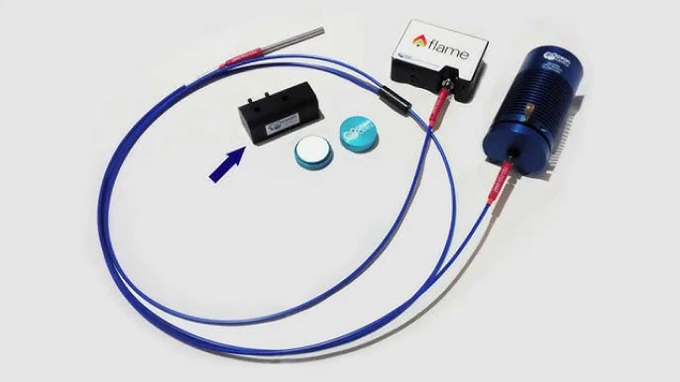
Spectrometry: the basics
Spec
Light
Probe(s)

Slide 2
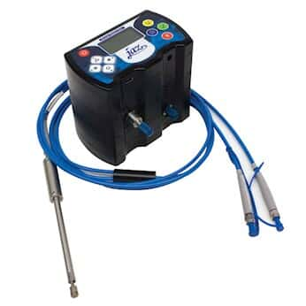
Spectrometry: data
Reflectance (relative)
Radiance
Irradiance (vector/scalar)
Transmittance (diffuse/direct)

Slide 3
Spectrometry: considerations
Greater
- The spec
- Light source
- Light <-> object <-> spec geometry
- Standards
Lesser
- Fibres (diameter/length/sensitivity)
- Filters/collimators/lenses
- Integration time
- Boxcar width/smoothing

Slide 4
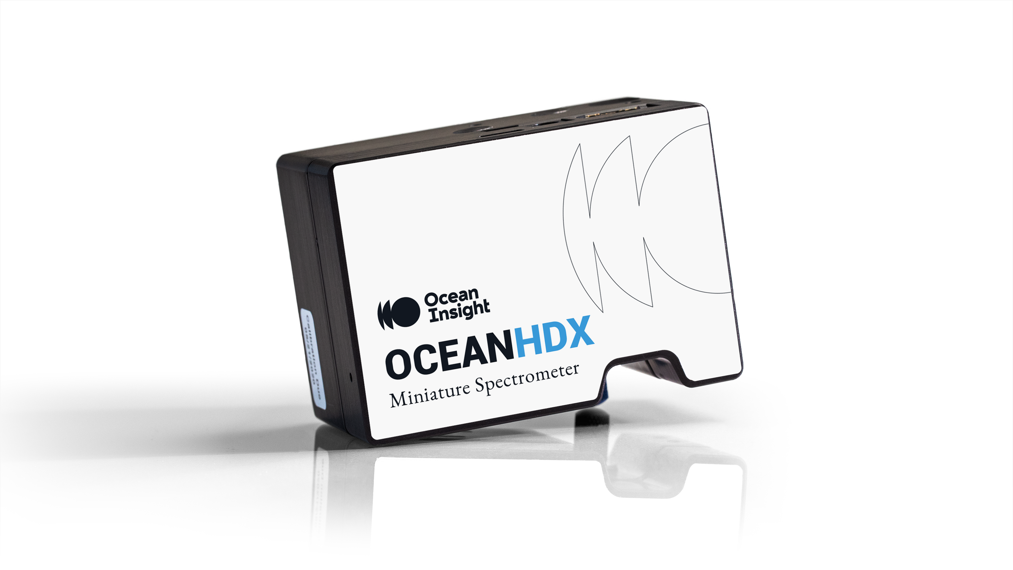
Spectrometry: the spec
Key: sufficient sensitivity across the spectral range
UV – VIS – NIR+
Sensitivity, noise, range
Lots of brands/types
Oceanview
Avantes
Horiba
StellarNet
Whatever Jolyon’s invented lately

Slide 5
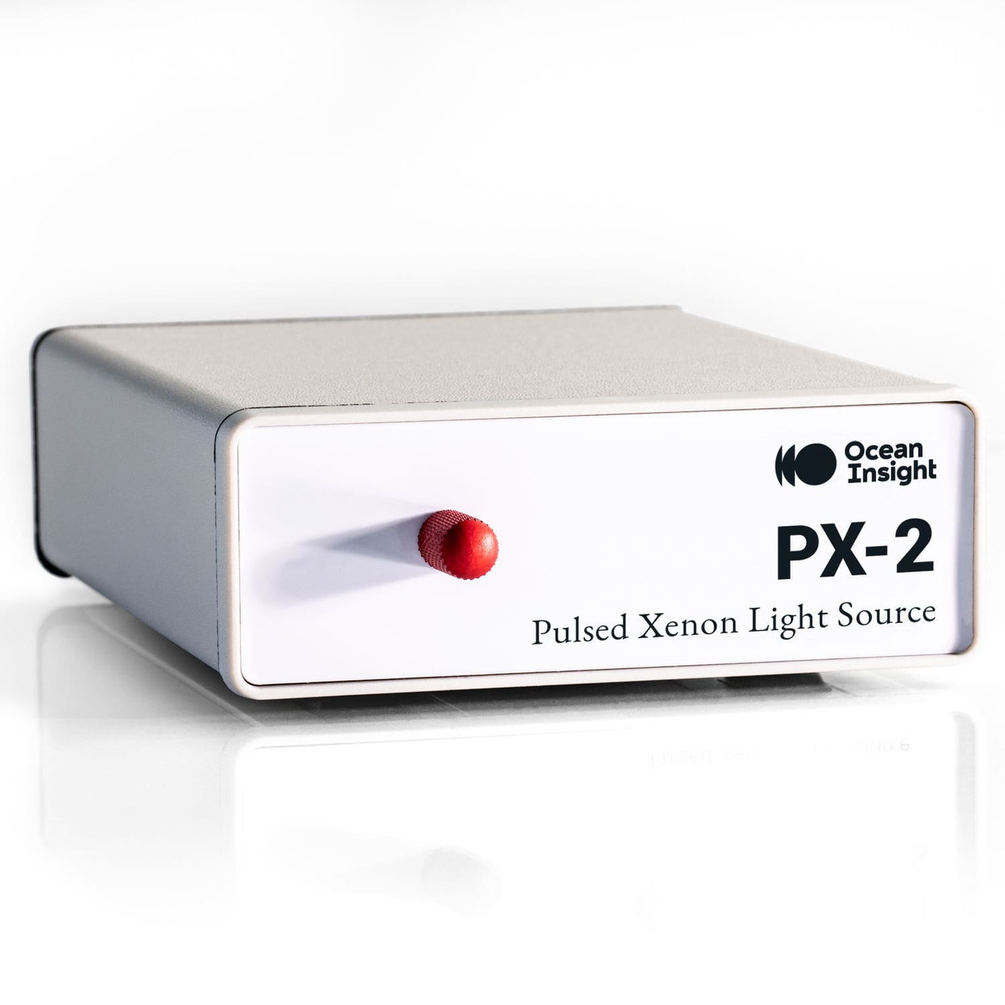
Light source
Key: sufficient intensity across the spectral range
Typically part of the whole setup, little ongoing consideration
BYO. Very rarely use ‘natural’ light, instead block ambient light and use:
Tungsten-Halogen
Deuterium
Xenon Arc Lamps
Light Emitting Diodes (LEDs)
Quartz Tungsten-Halogen (QTH) Lamps
Mercury Arc
...

Slide 6
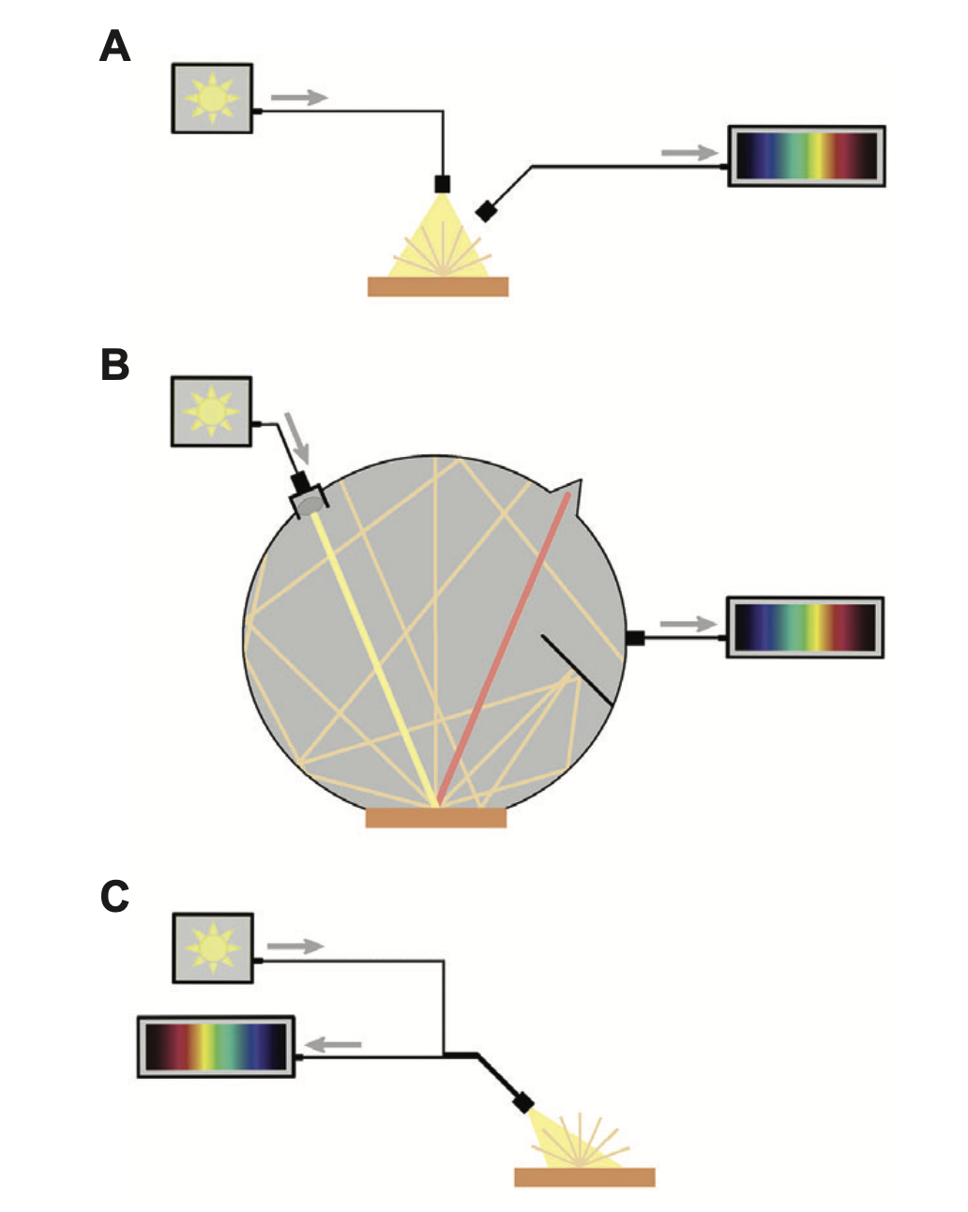
Geometry
Relationship between light, sample, collector
Need to consider specular (‘mirror’) vs diffuse samples & measurements
Need to take sample measurements under same setup (geometry, distances) as standards

Slide 7
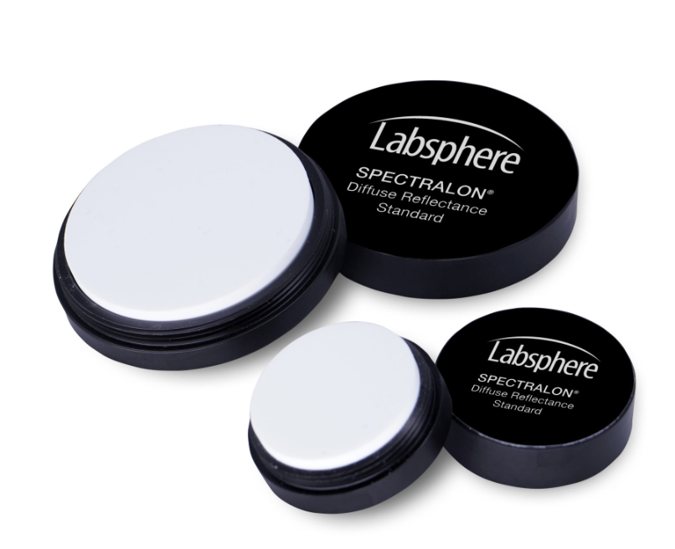
Standards
Reflectance is a relative measure
Light standards
Spectralon/teflon (PTFE)
Barium sulfate
Mirror (specular standard)
Dark
Block/unplug collector
Velvet
Recalibrate regularly to account for light drift, movement etc.

Slide 8
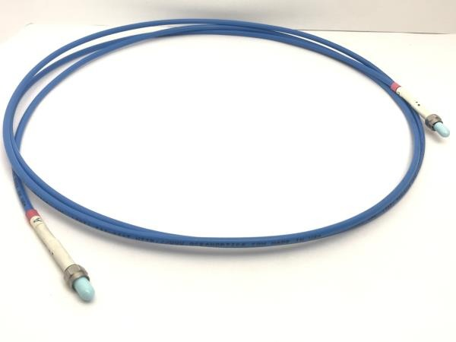
Other considerations
Hardware
- Fibres
- ~3-500 um common
- Collector/light spot sizes
- Spectral range/sensitivity
- Lenses
Settings
- Integration time
- Boxcar width/smoothing

Slide 9
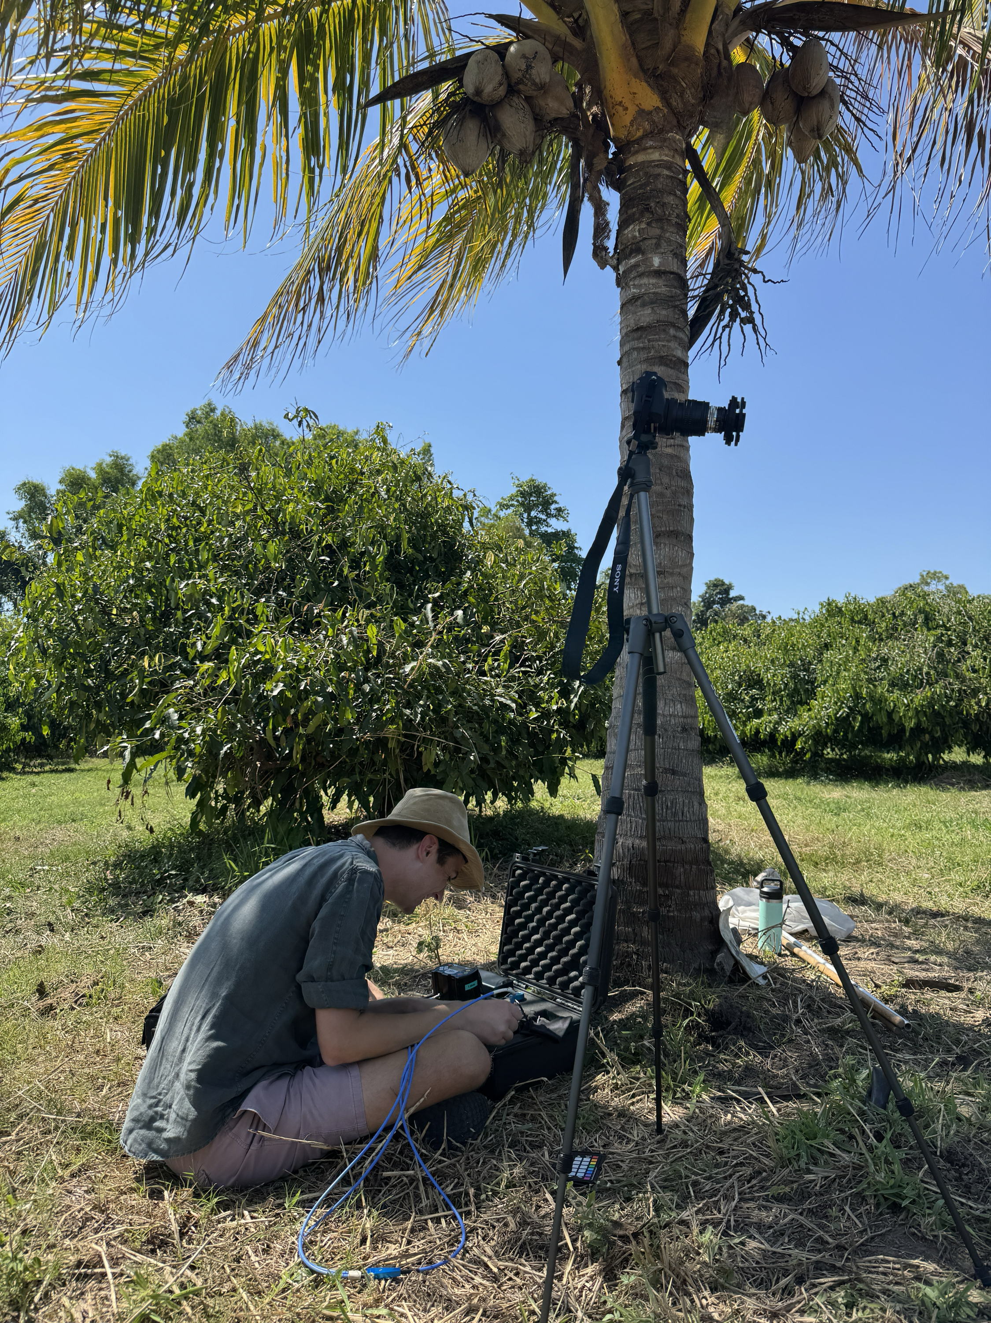
In practice
(1) Set up
- set geometry
- collection settings (boxcar, integration...)
(2) Calibrate
- light and dark standardise
(3) Record spectrum

